Slide 1
Present simple
IN THE AFTERNOON - odpoledne
ALWAYS - vždy
OFTEN - často
SOMETIMES - někdy
USUALLY - obvykle
IN THE EVENING
EVERYDAY - každý den
IN WINTER - v zimě
IN THE MORNING - ráno
NEVER - nikdy
IN SUMMER - v létě

Slide 2
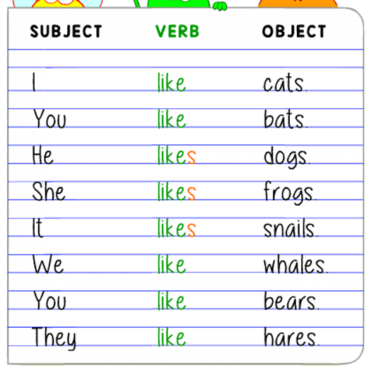
Positive sentence

Slide 3
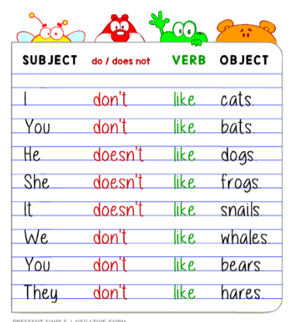
Negative sentence

Slide 4
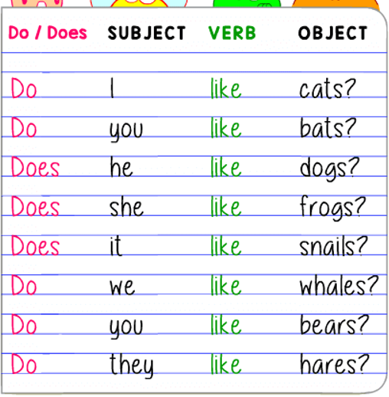
Question

Slide 5
Positive sentence
EAT PIZZA
GO TO SCHOOL
in the afternoon
WAKE UP
HAVE LUNCH
often
GO HIKING
WATCH FILMS
GET UP
everyday
at 8 a.m.
PLAY GAMES
GO OUT
always
BAKE CAKE
WATCH MOVIES
never
DO SPORTS
GET DRESSED
MAKE PRESENTS
usually
DO HOMEWORK
always
BRUSH MY TEETH
HAVE SNACK
in the evening
in summer
READ
DRINK COKE
sometimes
HAVE BREAKFAST
GO TO BED
in the morning

Slide 6
POSITIVE SENTENCE
Sometimes
Usually
Never
Often
Always
Everyday
Once a week
Twice a month/day
Three times a year
In the morning
At 7 a.m.
I
You
We
They
My parents
EAT PIZZA
GO TO SCHOOL
WAKE UP
HAVE LUNCH
GO HIKING
GET UP
WATCH FILMS
GET DRESSED
BAKE CAKE
liveS
In cage
He
Grandpa
She
(it)
Your rabbit
My mum
My dad
My friend
EATS PIZZA
GOES TO SCHOOL
WAKES UP
HAS LUNCH
GOES HIKING
GETS UP
WATCHES FILMS
GETS DRESSED
BAKES CAKE

Slide 7
POSITIVE SENTENCE

Slide 8
QUESTION SENTENCE
I
You
We
They
Your parents
EAT PIZZA
GO TO SCHOOL
WAKE UP
HAVE LUNCH
GO HIKING
GET UP
WATCH FILMS
GET DRESSED
BAKE CAKE
When
How often
Where
Why
What
DO
GO OUT
PLAY GAMES
LISTEN TO MUSIC
?
DOES
He
She
(it)
Your rabbit
Your mum
Your dad
Your friend
DO SPORTS
WATCH MOVIES
DRAW
DO HOMEWORK
HAVE SNACK
TAKE PHOTOS
BRUSH MY TEETH
DRINK COKE
FINISH SCHOOL
READ
GO TO BED
CHAT ONLINE
HAVE BREAKFAST
MAKE PRESENTS
HAVE AN ART LESSON

Slide 9
QUESTION SENTENCE

Slide 10
NEGATIVE SENTENCE
I
You
We
They
My parents
EAT PIZZA
GO TO SCHOOL
WAKE UP
HAVE LUNCH
GO HIKING
GET UP
Don’t
(do not)
WATCH FILMS
GET DRESSED
BAKE CAKE
GO OUT
PLAY GAMES
LISTEN TO MUSIC
He
She
(it)
my rabbit
My mum
My dad
My friend
My cousin
Doesn’t
(does not)
DO SPORTS
WATCH MOVIES
DRAW
DO HOMEWORK
HAVE SNACK
TAKE PHOTOS
BRUSH MY TEETH
DRINK COKE
FINISH SCHOOL
READ
GO TO BED
CHAT ONLINE
HAVE BREAKFAST
MAKE PRESENTS
HAVE AN ART LESSON

Slide 11
NEGATIVE SENTENCE

Slide 12
PRACTISE HERE
https://agendaweb.org/verbs/present_simple-exercises.html
https://agendaweb.org/verbs/present-simple-interrogative-exercises.html
https://agendaweb.org/verbs/present-simple-negative.html

