Slide 1
JOBS
manual
office work
part-time
full-time
stressful
well-paid
badly-paid
blue-collar
administrative
physically demanding
dangerous
repetitive
challenging
qualified
highly-skilled
unskilled
casual
rewarding
voluntary
boring
temporary
creative
tiring
sociable
paper
dream
weird

Slide 2
JOBS - applying for job
look for a job job agency advertisement
send an application (CV+a letter of application)
have a job interview prepare for the interview
ask questions > working hours
> duties
> salary
> holidays
answer the questions > experience
> education
> skills / qualification
get a job be employed get promoted
sign a contract have a day or two off
go to work, do overtime, work full-time/part-time
be fired/sacked - be dismissed - lose a job
be unemployed

Slide 3
JOBS - CV & letter of application
A letter of application
The reason you are writing
Why you are interested
Why you think you are good for the position
CV
Education
Experience
Qualification
Skills
Interests

Slide 4
FORMAL e-mails
SAYING HELLO
Dear Mr. … Dear Mrs. … Dear Ms.
Dear Sir or Madam
BEGINNING AN E-MAIL
I am writing to (apply for ..)
I am writing in response (to your advertisement)
I am writing to (apologize)
ENDING AN E-MAIL
I am looking forward to hearing from you soon.
I am looking forward to your answer.
Thank you for considering my application.
SAYING GOODBYE
Yours sincerely
Best regards

Slide 5
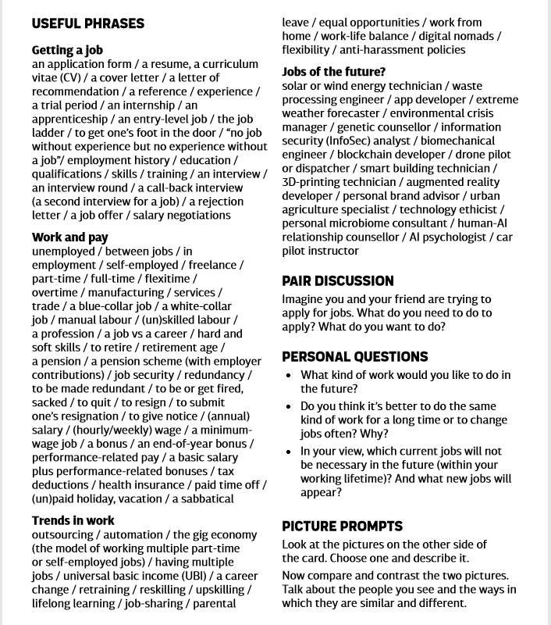

Slide 6


Slide 7


Slide 8
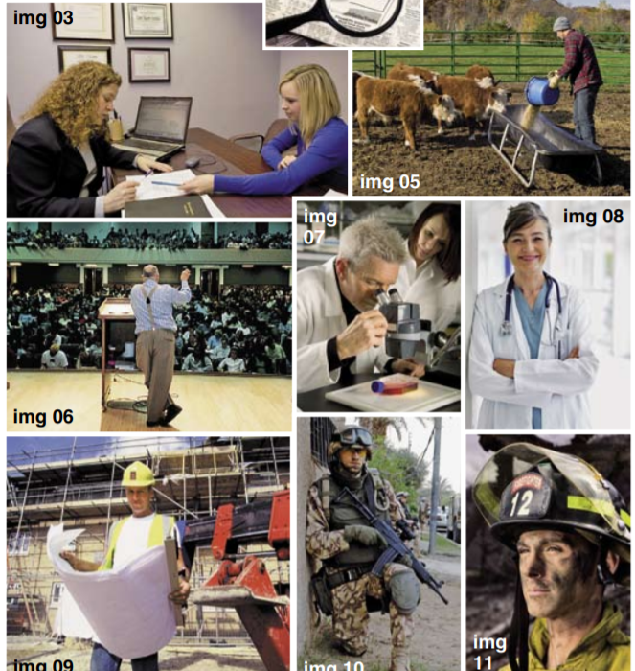

Slide 9


Slide 10
https://www.youtube.com/watch?v=wL3CFtW8WE0

