Slide 1
PAST SIMPLE
WHEN?
Yesterday
Last night
Yesterday evening
Two days ago
A year ago
A month ago
Last summer
An hour ago

Slide 2
PAST SIMPLE
POSITIVE SENTENCE
REGULAR
I WATCHed TV last night.
MY DAD CLEANed the house yesterday.
WE DANCEd at the wedding on Sunday.
IRREGULAR
Eat - ate
Drink - drank
Go - went
I drank A CUP OF TEA.
MY MUM drank A BEER AFTER LUNCH. .
WE went TO THE RESTAURANT ON SATURDAY.
VERB BE
I was hungry.
You, we, they were happy.
He, she, it was great.

Slide 3
PAST SIMPLE
MAKE SENTENCES WITH REGULAR VERBS (VERB+ED)
tidy, play, paint, walk, call, text
MAKE SENTENCES WITH IRREGULAR VERBS
go - went / get up / got up / buy - bought / swim - swam / see - saw

Slide 4
PAST SIMPLE
Watch the video
https://www.youtube.com/watch?v=g-uW_KheiEc
start drink go start
do need sing find
be eat enjoy
like have see
A dress Shopping a birthday song the theatre Cinderella Costumes
Homework Weather Fresh orange juice
Fast Rain
Make sentences in past about the video. Use the words above:

Slide 5
PAST SIMPLE
Watch the video and write down as many sentences in past simple as you can
Kung Fu Panda 2 Simple Past

Slide 6
PAST SIMPLE
Negative sentence -
He did not (didn’t) come from an egg.
They did not (didn’t) say anything.
They did not (didn’t) look for him.
VERB BE
He wasn’t born a goose.
They weren’t hungry.
Do the exercise
https://www.perfect-english-grammar.com/past-simple-exercise-4.html
Question ?
Did you lose some weight?
How many lessons did you have today?
What did you do yesterday?
Do the exercise:
https://www.perfect-english-grammar.com/past-simple-exercise-5.html

Slide 7
PAST SIMPLE
Click on the link and start doing the exercises
https://learnenglish.britishcouncil.org/english-grammar-reference/past-simple
Watch the video and write down as many sentences in past simple as you can
Kung Fu Panda 2 Simple Past

Slide 8
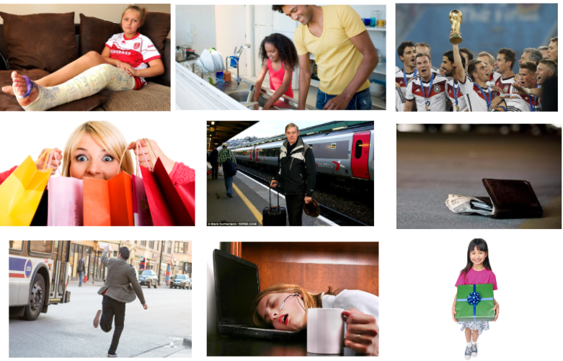
WORK A LOT
TRAVEL
WIN
LOSE
BREAK
GET
MISS
DO THE DISHES
GO SHOPPING/BUY

Slide 9
PAST SIMPLE
question
WHAT
the man
the woman
the girl
the team
dad and daughter
someone
WORK A LOT
WIN
WHERE
TRAVEL
?
DID
GET
WHY
LOSE
WHEN
BREAK
DO THE DISHES
HOW
MISS
GO SHOPPING/BUY

Slide 10
he went to visit his parents
they were not careful
he overslept
it was her birthday
she worked a lot
they worked out a lot
she won a lottery
they wanted to surprise their mum
she slipped on the ice

Slide 11
PAST SIMPLE
negative
WORK A LOT
WIN
The man
The woman
The girl
The team
Dad and daughter
Someone
TRAVEL
GET
DID not
(didn’t)
LOSE
DO THE DISHES
BREAK
GO SHOPPING/BUY
MISS

