Slide 1
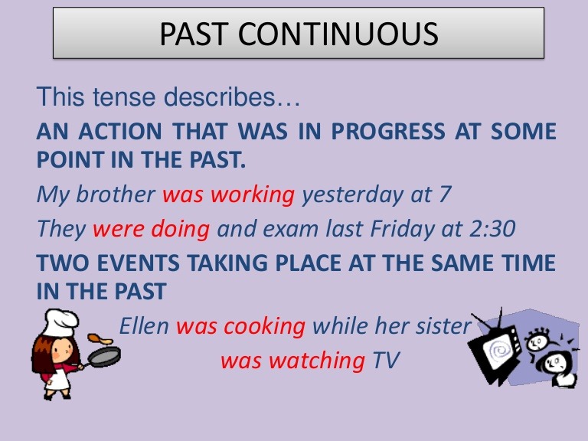
Past continuous
https://www.youtube.com/watch?v=t9t4rt7M6wU
I, he, she, it + WAS + _____ ing
I was work ing (at 3 p.m.)
you, we, they + WERE + _______ing
We were study ing (at 3 p.m.)

Slide 2
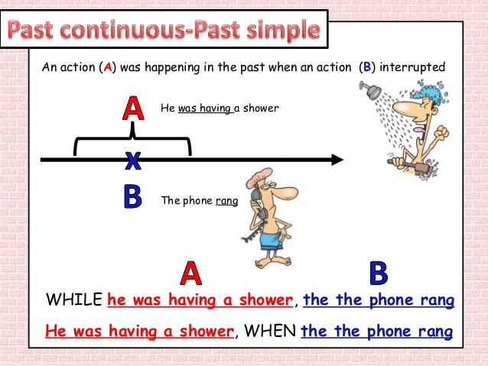
https://www.perfect-english-grammar.com/past-simple-past-continuous-exercise-1.html

