Slide 1
Politics of the US and basic facts
Laura Pokorová, Klára Máliková, Jitka Švandová, Klára Slováčková

Slide 2
Political system
The United States is federal constitutional republic
The head of the state is President of the United States
Legislative Power is in the two chambers of Congress
Two political parties – the Democratic Party and the Republican Party
  Have been the main participants in American politics since the American Civil War

Slide 3
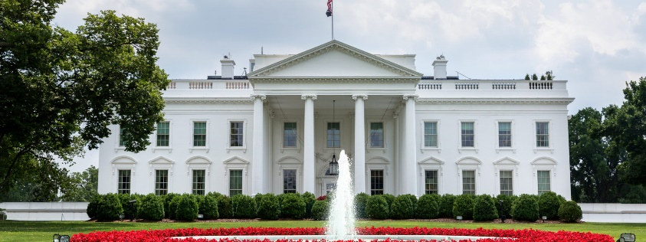
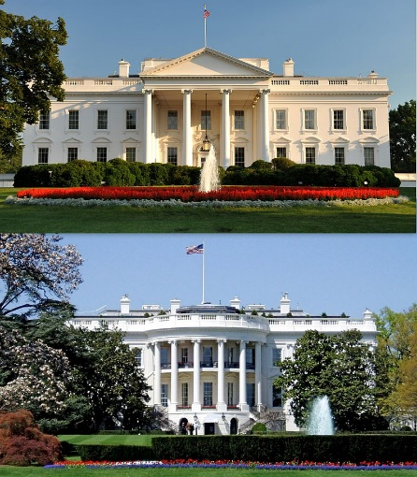
The White house
Is the official residence and workplace of the president of the US
  Also a home of the president of the US and his family
Has been the residence of every US president
It is located in washington D.C.
Picture
  Up: the North side
  Down: the South side

Slide 4
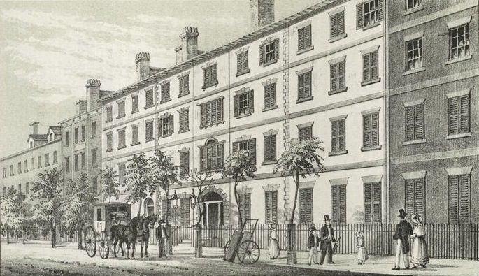
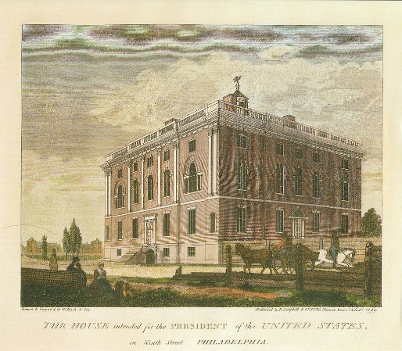
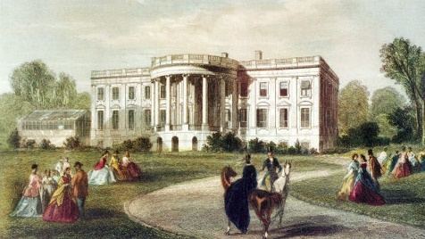
The White house
-history
construction took place around 1792–1801
the first prezident who lived here was John Adams (the second prezident of the US)
war of 1812, the British set fire to the President’s House in 1814
President Theodore Roosevelt officially gave the White House its current name in 1901
the wife of then-President J.F. Kennedy created here a museum of Americn history with a collection of presidential portraits

Slide 5
The White house
-now
since January 2017, the 45th US President Donald Trump has lived in it
the modern-day White House complex includes:
    the Executive Residence
    West and East Wing
    the Eisenhower Executive Office Building (now houses offices for the president's staff and the vice president)
    Blair House (a guest residence)

Slide 6
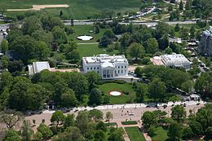
The White house
-now
today, the house convers an area of more than 5,100 m² on a plot of more than 7 hectares
there are 132 rooms, 35 bathrooms, and 6 levels in the Residence. There are also 412 doors, 147 windows, 28 fireplaces, 8 staircases, and 3 elevators

Slide 7
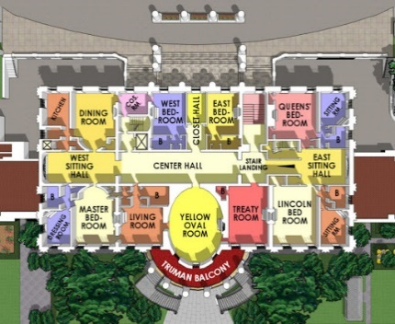
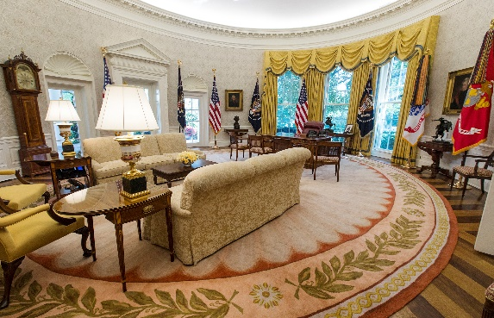
The White house
-now
The president‘s work place
The map of the White house

Slide 8
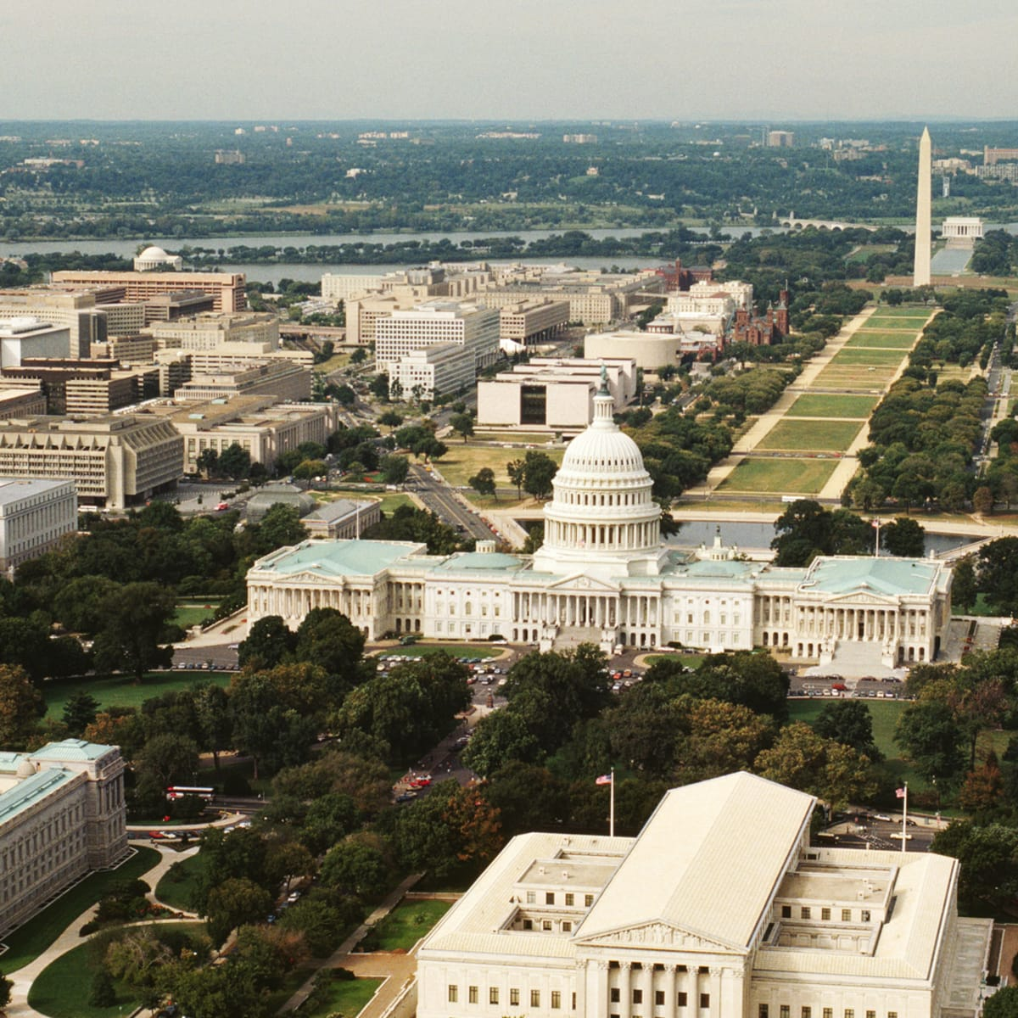
The capital-Washington D.C.
Washington D. C. = formally District of Columbia
  Named for George Washington (The first president of the United States)
Located on the Potomac River
One of the most visited cities in the United States – 20 milion visitors every year
Crime in washington D. C. is concentrated in areas associated with poverty and drugs
Washington D. C. is national center for the arts (Washington National Opera, Washington Ballet,..)

Slide 9
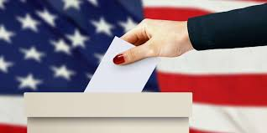
Elections
election take place in 4 steps:
  Primary
  Conventions
  Campaign
  Election day
primary elections begin in January - supporters of a political party choose a favorite from several candidates
the Democratic and Republican parties have their own rules

Slide 10
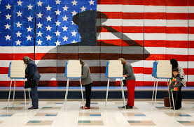
Elections
conventions are among the greatest events of American politics
delegations of individual states come to the conference hall with the name of the candidate
the candidates compete in their own presidential campaign, this phase is shorter than the primary.
candidates need to secure national television publicity and usually have three television debates

Slide 11
Elections
elections are always held on the Tuesday following the first Monday in November
After counting the votes, it is the turn of the voters

Slide 12
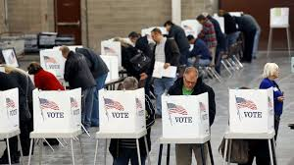
Elections
the Electoral College has a total of 538 votes - the presidential candidate must obtain at least 270 (simple majority) of them
the candidate who gets the most votes from the citizens is also getting all the votes of the electorate (except 2 states)
term of office lasts 4 years, president can be elected for a maximum of 2 terms

Slide 13
Articles of the constitution
it’s embody the doctrine of the separation of powers
the federal government is divided into three branches
    Legislative power – composed of a bicameral congress
    Executive power – consisting of the President and subordinate officials
    Judicial power – consisting of the Supreme Court and other federal courts

Slide 14
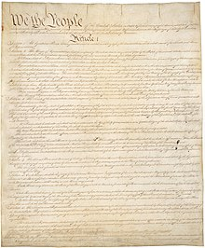
Articles of the constitution
describes the rights and obligations of states in relation to the federal government and the process of constitutional change
sets out the procedure laid down by the thirteen States for its ratification
the first ten amendments are known as the Bill of Rights.

Slide 15
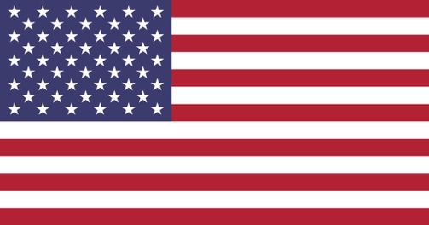
Flag
National flag of the United States
There are 50 stars on the flag
The 50 stars on the flag represent the 50 states of United States
There are 13 stripes – the stripes represents the FIRST thirteen British colonieS
The colors in the flag are red, blue and white – the colors have no special meaning
The flag i salso called „Stars and Stripes“ or „Old Glory“

Slide 16
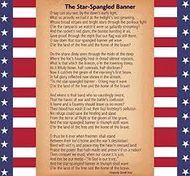
The US anthem-Star Spangled Banner
Written in 1814
Writer was an amateur poet Francis Scott Key
  In profession, he was a lawyer
  First name of anthem: The Defence of Fort McHenry (it was a poem)
  Three days later: To Anacreon in Heaven (now it was made into a song)
  Whole current name: Star Spangled Banner
Usually is played only first verse

Slide 17
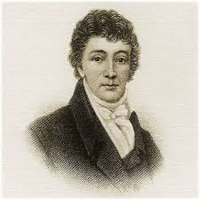
The Anthem-it is cruel?
The Anthem has to be written for a peace in the state
But…Scott Key was writing in it about slaves
  In fact he owns a few of them
  So he is rejected of BY US activists for cruelty
Woodrow Wilson
  Established first verse of an athem

Slide 18
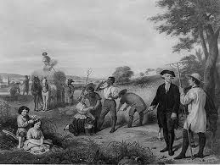
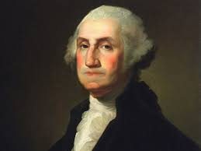
The first US president
-George Washington
Born in 1732 into a planter family in Virginia
he ended studies as 15 years old boy
  But he continues studying by himself
He inherit only a small farm
  His step brothers get much more of heritage

Slide 19
The first US president
-George Washington
He was gifted of mathematics
  Land surveryor and guide of the wild Virginia
He only gets once OUT of the US
  Into island Barbados because of his brother‘s illness
Married to a rich widow Martha Custis
  He never gets his own children

Slide 20
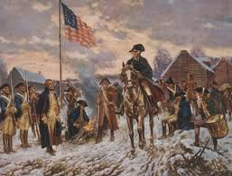
The first US president
-George Washington
Brave leader in Seven Year‘s war
  He was only 21 years old
  After war he was declared as a hero
He was invited on Constitutional Convention at Philadelphia in 1787
  They wanted him to be a first president
  He refused, he wanted to be a farmer
  Public wants him too, so he chanded his opinion

Slide 21
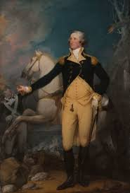
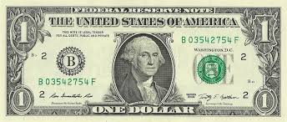
The first US president
-George Washington
He became president in 1789 (57 years old)
  Only 11 states of US
After his two terms he came back to a farm
Died of a throat infection in 1799 (67 years old)
  Buried on his farm
    Farm in Mount Vernon= national monument by year 1960
He is called as „father of the Nation
His portrait is on one dollar bank

