Slide 1
JOBS
manual
office work
part-time
full-time
stressful
well-paid
badly-paid
blue-collar
administrative
physically demanding
dangerous
repetitive
challenging
qualified
highly-skilled
unskilled
casual
rewarding
voluntary
boring
temporary
creative
tiring
sociable
paper
dream
weird

Slide 2
JOBS - applying for a job
look for a job job agency advertisement
send an application (CV+a letter of application)
have a job interview prepare for the interview
ask questions > working hours
> duties
> salary
> holidays
answer the questions > experience
> education
> skills / qualification
get a job be employed get promoted
sign a contract have a day or two off
go to work, do overtime, work full-time/part-time
be fired/sacked - be dismissed - lose a job
be unemployed

Slide 3
JOBS - CV & letter of application
The reason you are writing
A letter of application
Education
Skills
Character traits
Qualification
Why you are interested
Why you think you are good for the position
Experience
Interests
CV
Contact details
Interests

Slide 4
FORMAL e-mails
SAYING HELLO
Dear Mr. … Dear Mrs. … Dear Ms.
Dear Sir or Madam
BEGINNING AN E-MAIL
I am writing to (apply for ..)
I am writing in response (to your advertisement)
I am writing to (apologize)
ENDING AN E-MAIL
I look forward to hearing from you soon.
I am looking forward to your answer.
Thank you for considering my application.
SAYING GOODBYE
Yours sincerely
Best regards

Slide 5
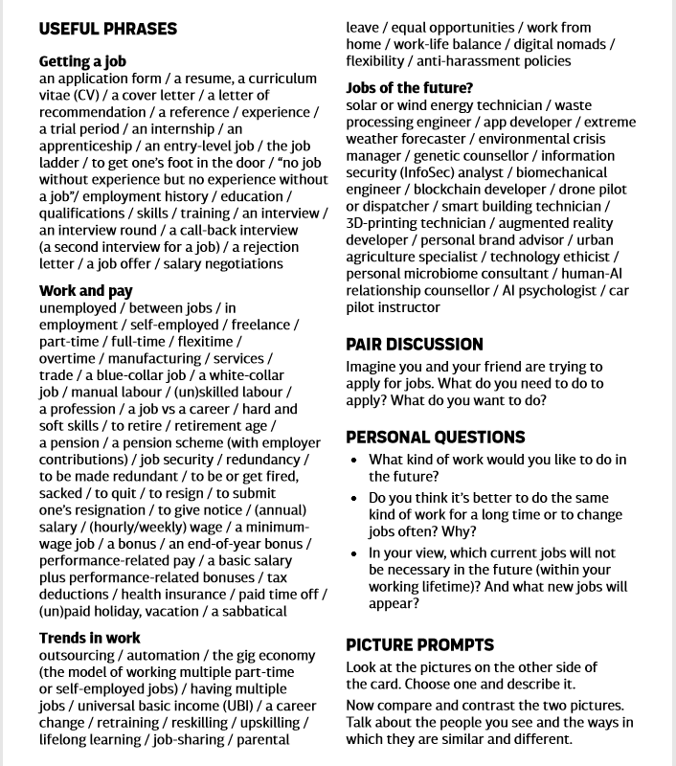

Slide 6
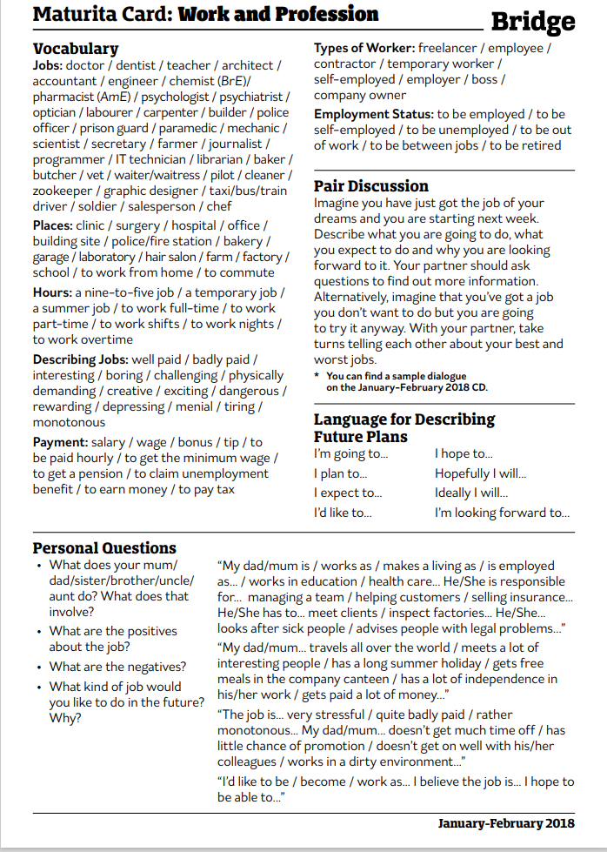

Slide 7


Slide 8


Slide 9
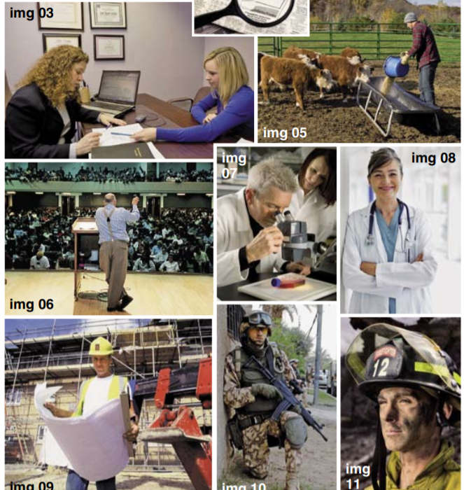

Slide 10


Slide 11
Describe these jobs...
The job of a farmer is …
The job of a doctor is …
The job of a builder is …
The job of a graphic designer is …

Slide 12
Likes and dislikes ...
using computers
working in the office
making phone calls
working with your hands
travelling for work
working alone
meeting people
selling things
dealing with the public
being creative
working in a team
helping people
being creative
meeting people
repairing things

Slide 13
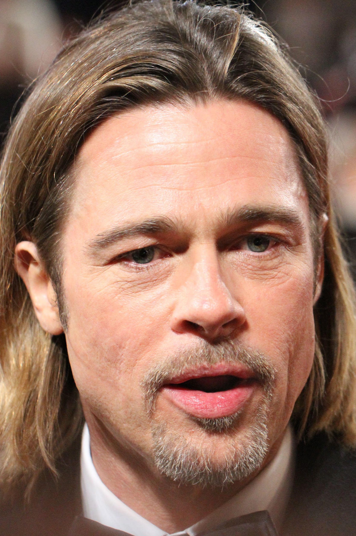
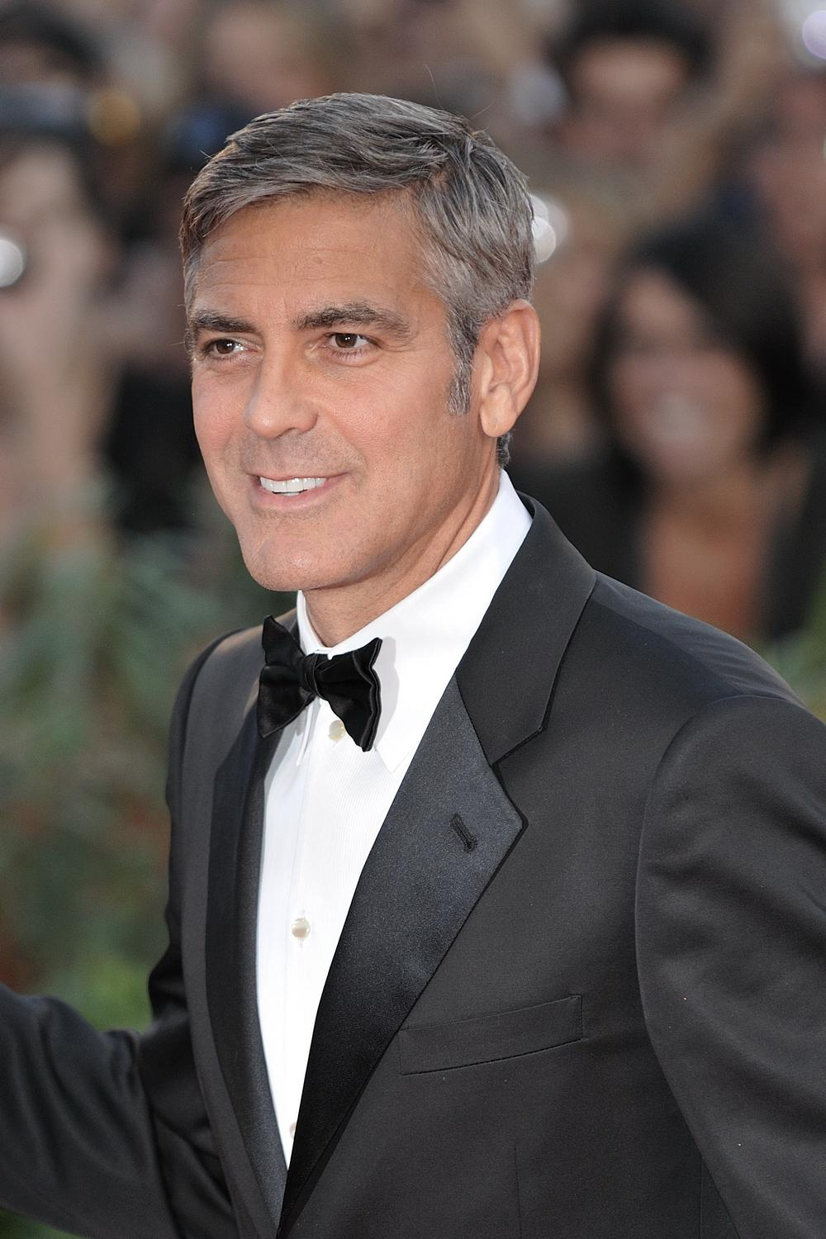
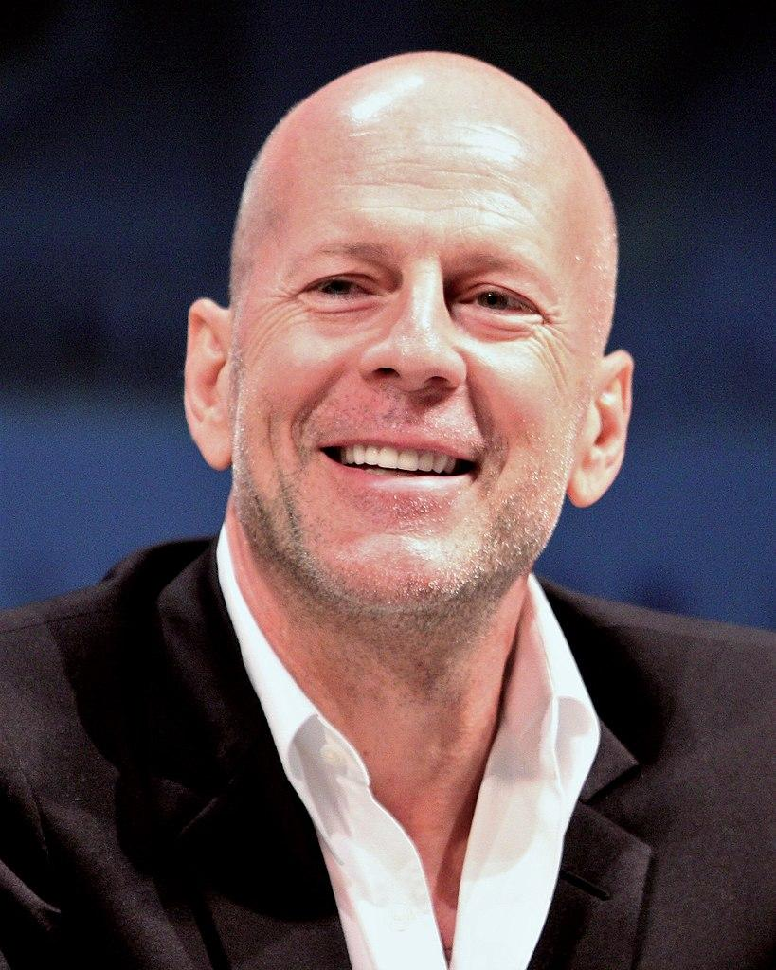
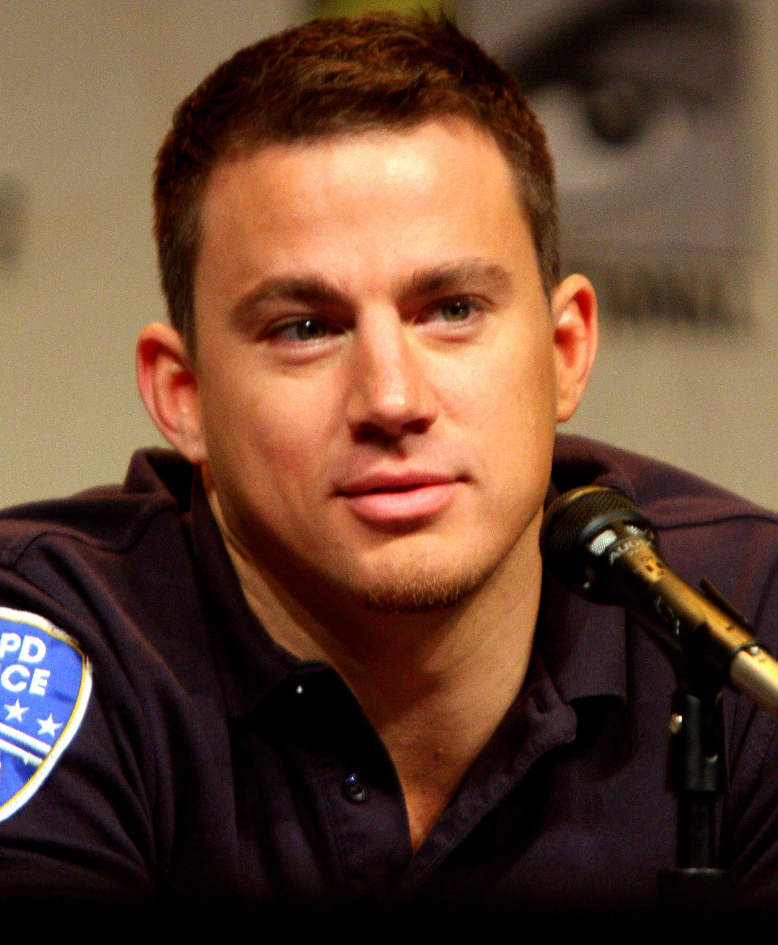

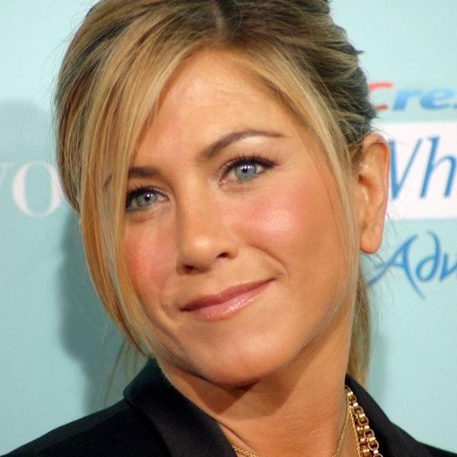

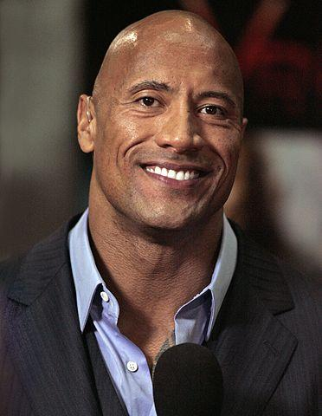
Before they were famous
a door-to-door salesman
a stripper
a bike messenger
a dishwasher
a courier
a private investigator
a subway employee
a waiter

Slide 14
https://www.youtube.com/watch?v=wL3CFtW8WE0

