Slide 1
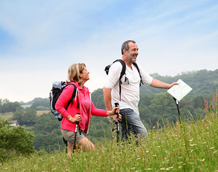
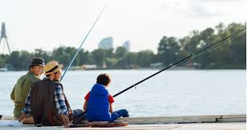
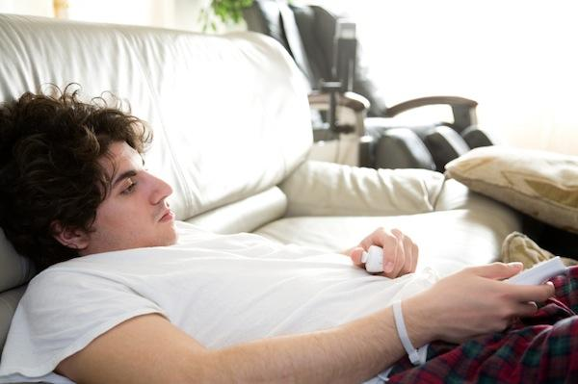
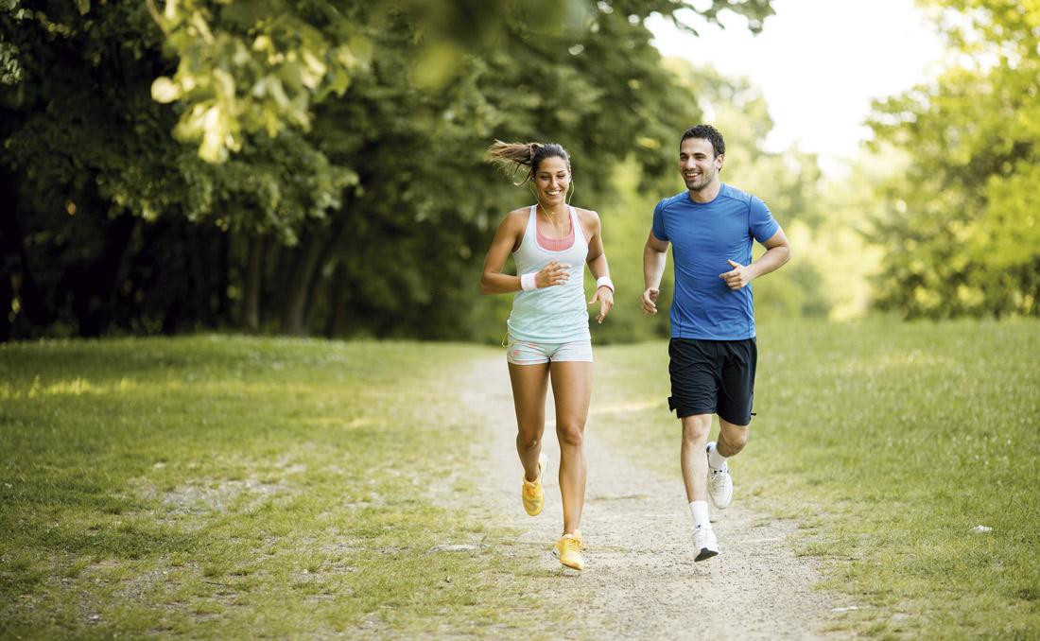
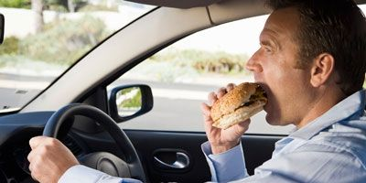
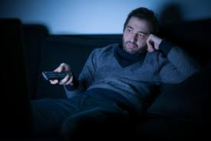
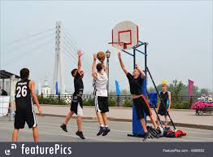
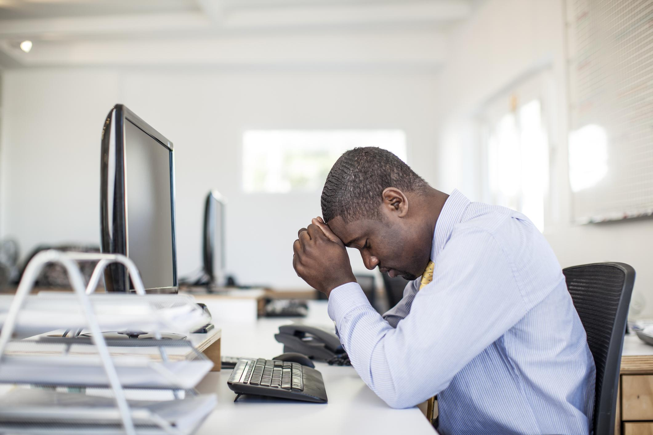
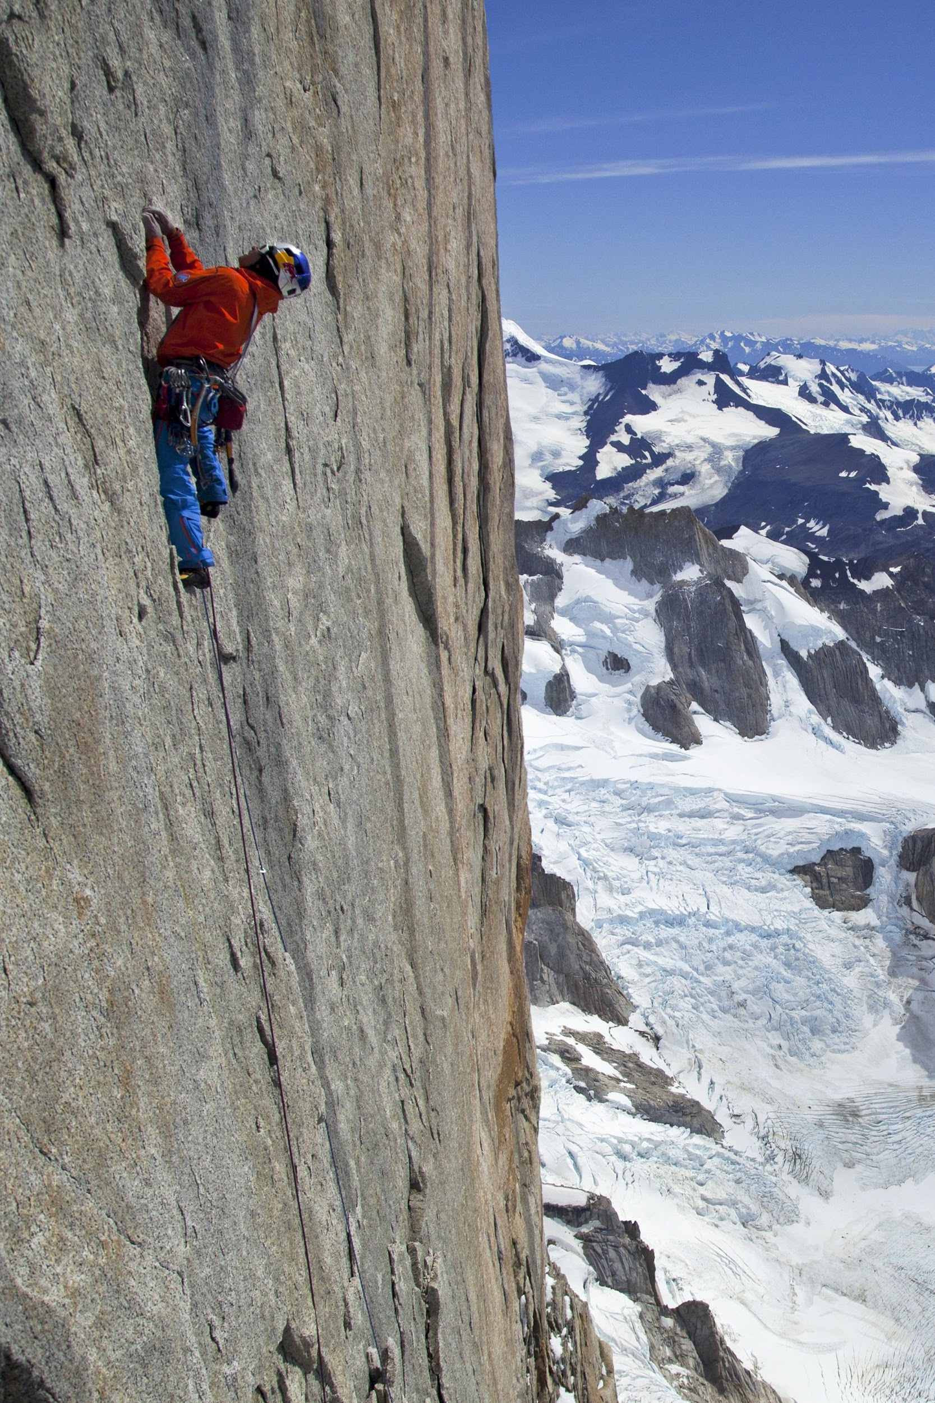
Healthy lifestyle
unhealthy
fun
easy
hard
busy
challenging
relaxing
active
passive
competitive
dangerous
healthy
boring
exciting
interesting
stressful

Slide 2
What do you do to keep fit/feel good?
daily routine
bad/good habits
food/drink
activities
sport
your personal hacks and tricks
Make sentences:
I …, I don’t, I always, never, often, sometimes...

Slide 3
What is Okinawa secret for longevity?
Watch the video. What are some reasons people live long in Okinawa?
https://www.youtube.com/watch?v=vwd-Y4z05AE

Slide 4
Vocabulary exercises
Exercise 1
https://www.helpforenglish.cz/article/2008031102-health-vocabulary-test
Exercise 2
https://www.english-4u.de/en/quizzes/health2.htm
Exercise 3
https://www.englishtestsonline.com/health-vocabulary-test/
Exercise 3
https://www.flo-joe.co.uk/preliminaryenglish/vocabulary/health-problems.htm
Exercise 4
https://www.flo-joe.co.uk/preliminaryenglish/vocabulary/health-treatment.htm

